Slide 1
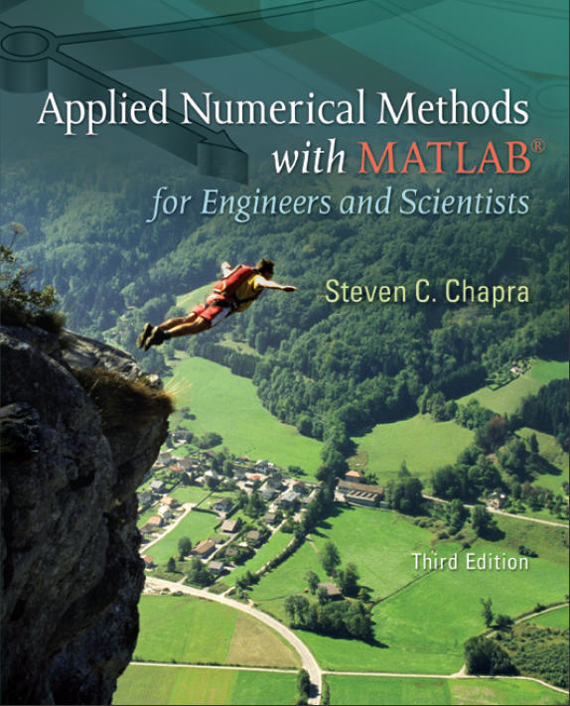
Part 4
Chapter 15
General Linear
Least-Squares and Nonlinear Regression
PowerPoints organized by Dr. Michael R. Gustafson II, Duke University
All images copyright © The McGraw-Hill Companies, Inc. Permission required for reproduction or display.

Slide 2
Chapter Objectives
Knowing how to implement polynomial regression.
Knowing how to implement multiple linear regression.
Understanding the formulation of the general linear least-squares model.
Understanding how the general linear least-squares model can be solved with MATLAB using either the normal equations or left division.
Understanding how to implement nonlinear regression with optimization techniques.

Slide 3
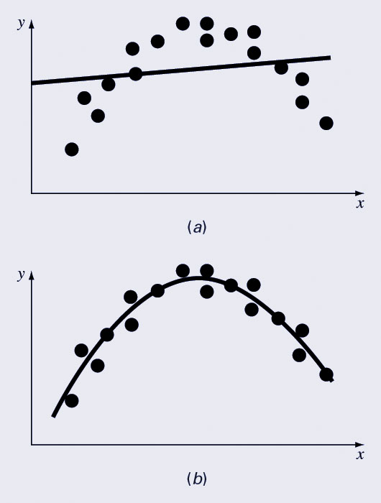
Polynomial Regression
The least-squares procedure from Chapter 13 can be readily extended to fit data to a higher-order polynomial. Again, the idea is to minimize the sum of the squares of the estimate residuals.
The figure shows the same data fit with:
  A first order polynomial
  A second order polynomial

Slide 4
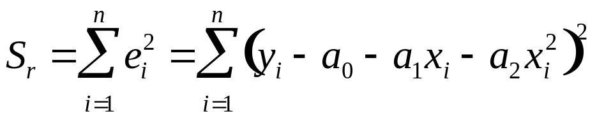
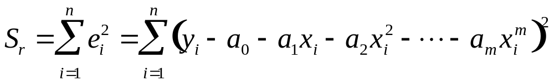
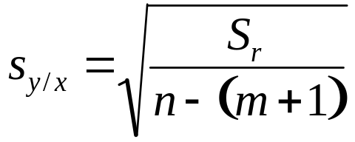
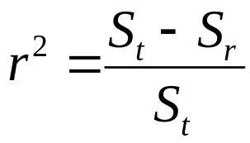
Process and Measures of Fit
For a second order polynomial, the best fit would mean minimizing:
In general, this would mean minimizing:
The standard error for fitting an m^{th} order polynomial to n data points is:
because the m^{th} order polynomial has (m+1) coefficients.
The coefficient of determination r² is still found using:

Slide 5
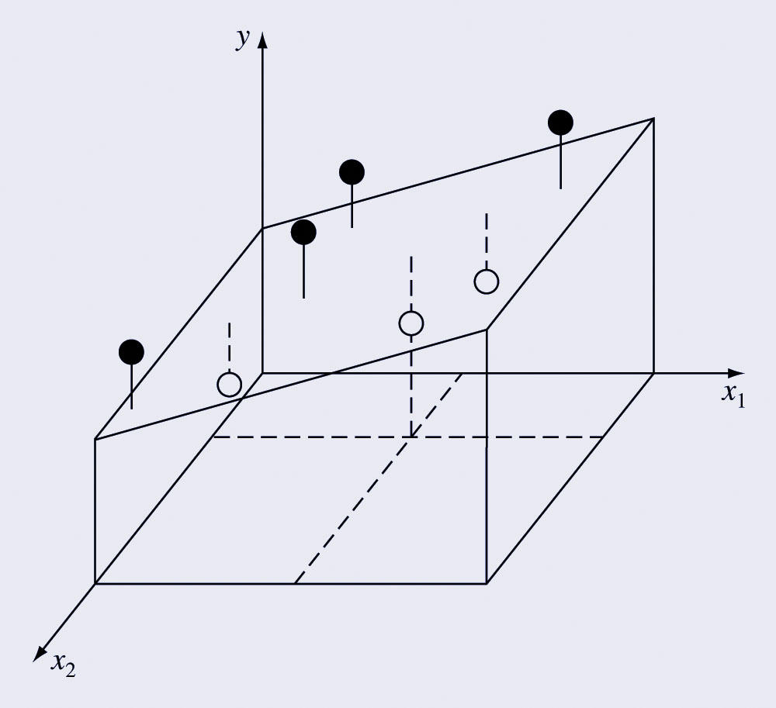

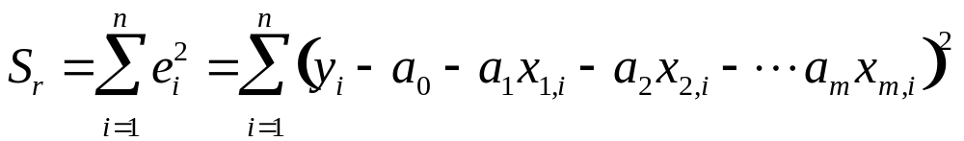
Multiple Linear Regression
Another useful extension of linear regression is the case where y is a linear function of two or more independent variables:
Again, the best fit is obtained by minimizing the sum of the squares of the estimate residuals:

Slide 6
General Linear Least Squares
Linear, polynomial, and multiple linear regression all belong to the general linear least-squares model:
where z₀, z₁, …, z_{m} are a set of m+1 basis functions and e is the error of the fit.
The basis functions can be any function data but cannot contain any of the coefficients a₀, a₁, etc.

Slide 7

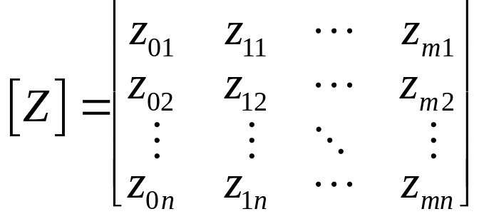
Solving General Linear Least Squares Coefficients
The equation:
can be re-written for each data point as a matrix equation:
where {y} contains the dependent data, {a} contains the coefficients of the equation, {e} contains the error at each point, and [Z] is:
with z_{ji} representing the the value of the j_{th} basis function calculated at the i_{th} point.

Slide 8
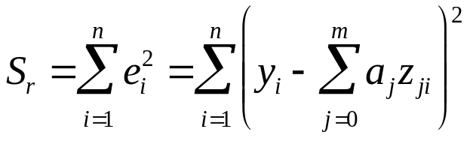
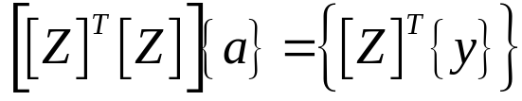
Solving General Linear Least Squares Coefficients
Generally, [Z] is not a square matrix, so simple inversion cannot be used to solve for {a}. Instead the sum of the squares of the estimate residuals is minimized:
The outcome of this minimization yields:

Slide 9
MATLAB Example
Given x and y data in columns, solve for the coefficients of the best fit line for y=a₀+a₁x+a₂x²
Z = [ones(size(x) x x.^2]
a = (Z’*Z)\(Z’*y)
  Note also that MATLAB’s left-divide will automatically include the [Z]^{T} terms if the matrix is not square, so
  a = Z\y
  would work as well
To calculate measures of fit:
St = sum((y-mean(y)).^2)
Sr = sum((y-Z*a).^2)
r2 = 1-Sr/St
syx = sqrt(Sr/(length(x)-length(a)))

Slide 10
Nonlinear Regression
As seen in the previous chapter, not all fits are linear equations of coefficients and basis functions.
One method to handle this is to transform the variables and solve for the best fit of the transformed variables. There are two problems with this method:
  Not all equations can be transformed easily or at all
  The best fit line represents the best fit for the transformed variables, not the original variables.
Another method is to perform nonlinear regression to directly determine the least-squares fit.

Slide 11
Nonlinear Regression in MATLAB
To perform nonlinear regression in MATLAB, write a function that returns the sum of the squares of the estimate residuals for a fit and then use MATLAB’s fminsearch function to find the values of the coefficients where a minimum occurs.
The arguments to the function to compute S_{r} should be the coefficients, the independent variables, and the dependent variables.

Slide 12

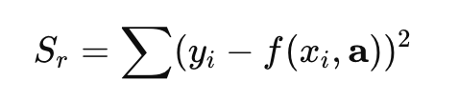
Nonlinear Regression in MATLAB
Given dependent force data F for independent velocity data v, determine the coefficients for the fit:
First - write a function called fSSR.m containing the following:
function f = fSSR(a, xm, ym)
yp = a(1)*xm.^a(2);
f = sum((ym-yp).^2);
Then, use fminsearch in the command window to obtain the values of a that minimize fSSR:
a = fminsearch(@fSSR, [1, 1], [], v, F)
where [1, 1] is an initial guess for the [a0, a1] vector, [] is a placeholder for the options

Slide 13
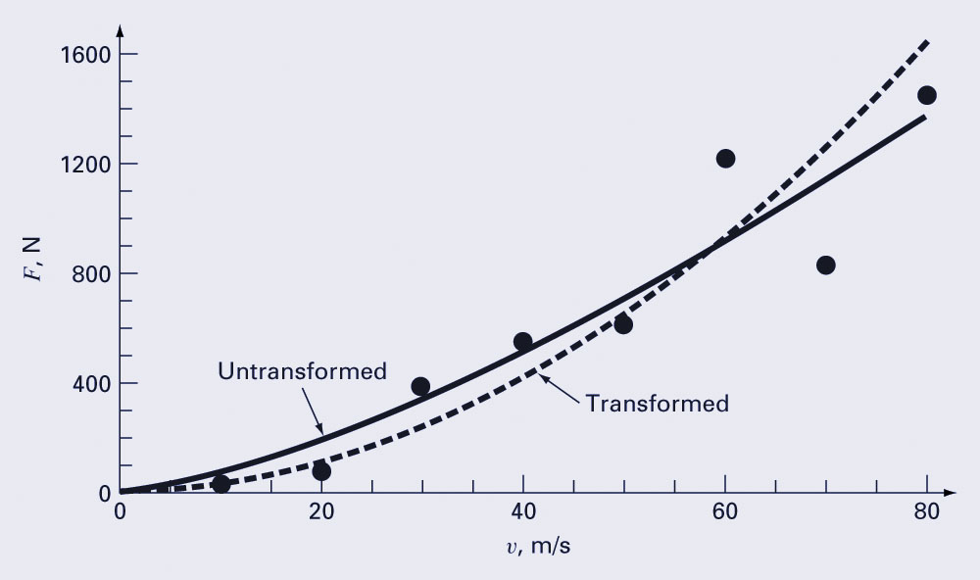
Nonlinear Regression Results
The resulting coefficients will produce the largest r² for the data and may be different from the coefficients produced by a transformation:

